Slide 1
Network Forensics
Switches, Routers, and Firewalls
Week 10
S. Pradono Suryodiningrat
satrio.Pradono@binus.ac.id

Slide 2
Session Learning Outcomes
Upon completion of this session, students are expected to be able to
Identify different techniques of capturing digital evidence from a scene in network forensics, technology, and principles
Define appropriate tools necessary to sample, seal, and dissect a given intrusion evidence, and concept of network forensics and traffic analysis
Conduct laboratory experiments in network forensics and evidence handling

Slide 3
Storage Media
ROM
NVRAM
DRAM
CAM
Hard Drive

Slide 4
Switches
Maps MAC addresses to switch ports
Locate physical location of MACs
ARP tables

Slide 5
CAM Tables
Very fast memory
Maps MAC Addresses to physical switch ports
Switch looks up MAC in table
Writes packet to the correct port
If an attacker is sniffing local traffice it will show up in the CAM table
The CAM table is very volatile

Slide 6
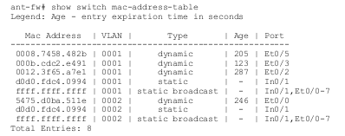
CAM Table
“Age” is the number of seconds left before the entry expires.

Slide 7
ARP Tables
MAC address to IP address resolution
Format of table entry
Location of the ARP requeset
IP Address
MAC address
Age in seconds from initial ARP request

Slide 8
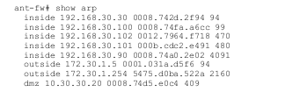

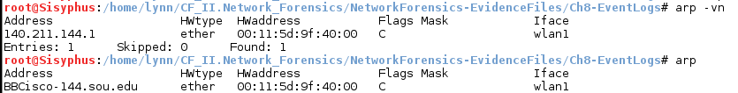
ARP Table
Cisco ASA 5505 firewall
Ubuntu Server
Arp table for a linux workstation

Slide 9
Managed Switches
Enterprise LANS
Support for VLAN, ACLs
Arp caching, 802.1 authentication
Port mirroring/monitoring
Event logging
Config Interfaces
CLI, SSH/Telnet, SNMP, Web, Proprietary- Cisco
Performance Monitoring

Slide 10
Smart Switches
Subset of Managed Switches
VLANs
ARP caching
Port mirroring
Some performance monitoring
Config Interface
Usually Web
CLI and remote CLI

Slide 11
Home Switches
Unmanaged Switches
Plug and play
No configuration interface
No accessible stored data
No/limited forensic value

Slide 12
Switch Evidence
Volatile Data
Stored packets ( prior to forwarding)
CAM tables (MAC to port mappings)
ARP Table (MAC to IP address mappings)
ACLs, Running configuration
Flow data and performance stats
Non-Volatile Data
OS image and Startup configuration
Off-System
Logging data
Flow data

Slide 13
Routers - Why?
Network topology
Traffic through the router
Logged data
all routers are capable of extensive logging
The router itself may be compromised!
Types of Routers
Enterprise
Consumer
Custom – Linux boxes

Slide 14
Enterprise router
Extensive selection - $ - $$$$$
Capabilities
Stateful packet filtering
Supports many routing protocols
Multiprotocol Label Switching
High-availability, high-throughput
DHCP, NAT QoS
Performance monitoring
Event logging

Slide 15
Router Interfaces
Configuration Interfaces
CLI, Telnet/SSH, SNMP
Web interface
Cisco Proprietary
Central Management
Cisco Works Management Center
Central management
Central management of large numbers of touters
Cisco ASA seties
Juniper J-Series

Slide 16
Consumer Grade Routers
Linksys, D-Link, ISP Custom
Often supplied by the ISP
Caution!
Capabilities
ISP connection via PPPoE
DHCP, NAT
802.11 wireless interface
Port Filtering
Easy config via Web interface
Remote access to config

Slide 17
Router Evidence Volatile
Routing Tables
Packet counts & stats
ARP table
DHCP lease assignments
ACLs
Running config
Flow data & stats
I/O and processor memory

Slide 18
Router Evidence Non-Volatile
OS image
Boot loader
Stored configuration
Access logs
DHCP logs

Slide 19
Router Evidence Remote
Configurable – via
Syslog, FTP, TFTP, SNMP
Access history
DHCP logs
Backup configuration
Flow data

Slide 20
Firewalls
Firewall logs include extensive info
Connection attempts
Success or failure
Protocols used
Applications
Configuration
What does the world see
Net topology
Configurable to collect more data
Firewall may be compromised

Slide 21
Firewall Types
Packet Filters
Iptables types
Session-Layer Proxies
Source establishes connection with proxy
Destination establishes connection with proxy
Man in the middle intercept of SSL connections for deep packet inspection of encrypted traffic
Application Proxies
Enables inspection of layer 7 traffic

Slide 22
Enterprise-class Firewalls
Often higher layer proxies are often standalone devices
Firewall features/capabilities
NAT, DHCP, VPN tunneling
Load balancing
Fail over
Fragmentation reassembly
Stateful filtering, performance monitoring
Centralized management, Event logging
HW upgrades

Slide 23
Configuration Interfaces
CLI
Remote CLI via SSH/Telnet
SNMP
Web interface
Proprietary
Remote access = insecurity!

Slide 24
Consumer Grade Firewalls
Provides
NAT
DHCP
WiFi interface
Some packet filtering
Some logging

Slide 25
Firewall Evidence
Volatile
Similar to routers
Command history
Persistent
Boot load, startup config
Access logs, DHCP logs
Firewall rules and exceptions
TURN IT ON
Remote
Usual logs

Slide 26
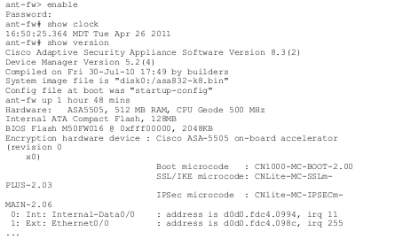
Interfaces
CLI
Cisco ASA 5505 is typical

Slide 27
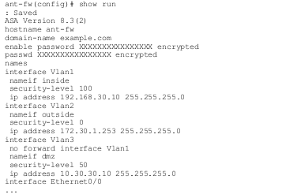
Cisco ASA 5505 Continued

Slide 28
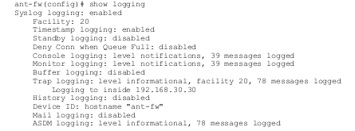
Logging
Cisco ASA 5505

Slide 29
Other Logs
Syslog, rsyslog, etc.
AAA logs
Authentication
Authorization
Accounting
Files usage logs

